Slide 1


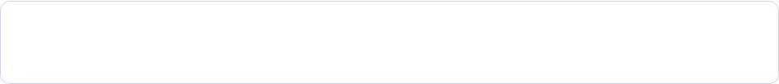
Resume–Job Matching &
Talent-Marketplace Engine
An Algorithmic System for Initial Résumé Screening, Skill Organization, and Role Shortlisting
Team Members
CH.Ganesh -2520090112
A.Sai Charan Teja-2520080044
Course
Data Structures & Algorithms-3
Department of
CS&IT and AIDS

Slide 2








Abstract
What the Project is
Why It Is Needed
A computational tool designed to process applicant résumés and job descriptions, extract skill data, organize candidate profiles using fundamental data structures, and compute objective job-fit scores.
Hiring managers receive hundreds of applications per job posting. Manual screening is extremely slow, prone to bias, and inefficient when comparing skill sets across multiple candidates.
How It Helps Recruiters
Expected System Output
Automates initial application filtering, converts unstructured text into structured candidate records, and sorts applicants by suitability to reduce recruitment turnaround time.
A structured ranking of candidate profiles per job opening with percentage fit scores, enabling quick shortlisting for interview rounds.

Slide 3






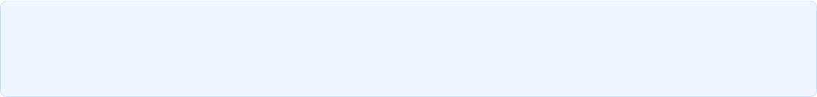

Introduction & Problem Statement
High Resume Volume
Skill Vocabulary Variations
Multi-Job Allocation
Recruiting platforms receive massive volumes of applicant résumés. Reading through every document manually requires unsustainable hours of manual labor.
Candidates write the same skills in different ways (e.g., "JS" vs "JavaScript" or "Python 3" vs "Python Programming"), confusing simple filters.
Assigning multiple applicants to suitable open roles based on varying requirements is difficult without structured sorting and indexing.
Algorithmic Solution
By applying foundational Data Structures and Algorithms, we can systematically parse, organize, compare, and score applicant data—providing a fast and consistent automated screening engine.

Slide 4
Literature Survey
System Type | Core Approach | Key Limitations
Traditional ATS Tools | Basic exact string matching for mandatory job keywords. | Rejects good candidates due to minor spelling/formatting differences.
Rule-Based Systems | Manual IF-THEN rules set up by recruiters for filtering. | Difficult to maintain and update as job skills evolve.
Skill Matrix Tables | Tabular check-lists matching applicant skills to role lists. | Lacks automated ranking and similarity scoring metrics.
Basic Recommenders | Simple frequency counting of matching words in text. | Overcounts repeated words regardless of candidate relevance.
Takeaway for Our Project: Existing simple systems either depend on manual entry or rigid exact text matches. There is a need for an organized, data-structure-driven matching engine that scores candidates fairly and efficiently.

Slide 5




Existing System & Limitations
Current Recruitment Workflow
Major Inefficiencies
Recruiters manually download and skim PDF/Word résumés.
Time-Consuming: Days spent reading applications per open role.
Search bar queries rely on exact keyword presence.
High Error Rate: Qualified candidates missed due to non-standard resume formats.
Candidate suitability is judged subjectively by individual recruiters.
No standardized numerical score for candidate comparison.
Poor Scalability: Performance drops rapidly as applicant count grows.
Lack of Structure: Information remains trapped in unstructured text files.

Slide 6

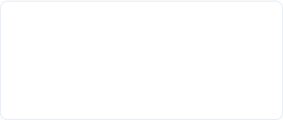
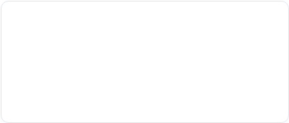








Proposed System
1. Data Ingestion
2. Skill Extraction
3. Data Organization
Collects résumés and job descriptions, converting unstructured text into clean data formats for processing.
Identifies key candidate skills, experience levels, and job requirements using predefined skill dictionaries.
Stores candidate profiles and job requirements using efficient structures like Hash Tables and Arrays for quick lookup.
4. Fit Score Calculation
5. Candidate Ranking
6. Role Recommendation
Compares candidate skill sets against job requirements to compute a clear percentage match score.
Sorts applicants by matching score using efficient sorting algorithms to present top candidates first.
Generates shortlists for hiring managers and suggests suitable alternative roles for candidates.

Slide 7




Software Requirements
Programming Languages & Runtime
Development Environment & Tools
  • Primary Language: Java / HTML,CSS,JS
  • Data Format: JSON / CSV files for résumé and job inputs
• IDE: Visual Studio Code
• Operating System: Windows 10/11
• Version Control: Git & GitHub for project collaboration
• Database (Optional): MySQL / SQLite for record storage
Design Note: The software stack is lightweight and standard, ensuring easy setup, execution, and testing across standard academic environments without complex external dependencies.

Slide 8
Hardware Requirements
Component | Minimum Specification | Recommended Specification
Processor (CPU) | Intel Core i3 (Dual Core) or equivalent | Intel Core i5 / AMD Ryzen 5 or above
System Memory (RAM) | 4 GB RAM | 8 GB RAM or higher
Storage Space | 10 GB available HDD/SSD space | 20 GB SSD storage
Display | 1280 × 720 resolution screen | 1920 × 1080 (Full HD) Monitor
Peripherals | Standard Keyboard and Optical Mouse | Standard Keyboard and Mouse
Connectivity | Not required for offline local processing | Standard Internet for repository updates

Slide 9
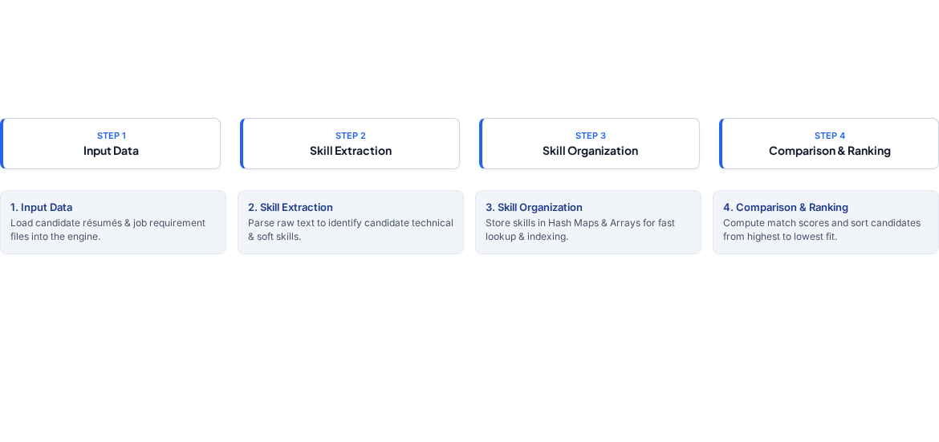
System Methodology
Process Summary: The pipeline receives unstructured text, transforms it into indexed data structures, performs set-overlap comparison, and outputs a sorted shortlist of best-matching candidates.

Slide 10

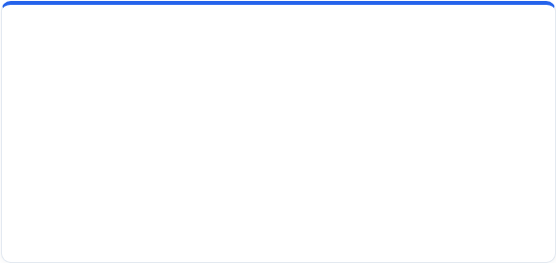


Expected Outcome & Conclusion
Expected Project Outcomes
Future Scope (Advanced DSA)
Faster Screening: Automates initial résumé filtering in seconds.
String Matching (KMP & Rabin-Karp): For high-speed pattern searching across large text databases.
Objective Scoring: Provides consistent match percentages per candidate.
Automated Ranking: Sorts top applicants to simplify recruiter decision-making.
Dynamic Programming (Edit Distance): To handle spelling variations and typos automatically.
Practical DSA Application: Demonstrates real-world usage of arrays, hash tables, and sorting.
Network Flow (Edmonds-Karp): For multi-role candidate assignment under capacity limits.
Set Cover Optimization: To assemble optimal teams with minimal hiring costs.

